Slide 1
Project1

Slide 2
Outline
BFS, DFS
A* graph search route finding/searching
8 puzzle problem
Notes:
今天主要给大家讲一下上次课布置的project，一是用BFS,DFS和A*进行路径搜索，二是用A*算法来解决八数码问题。这两个问题都可以看作是寻找从初始状态到目标状态的路径的问题。

Slide 3
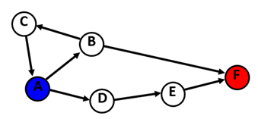
BFS, DFS
BFS Review
Strategy: expand a shallowest node first
implementation: use FIFO queue
DFS review
Strategy: expand a deepest node first
Implementation: use LIFO stack
Notes:
首先来简要的复习一下BFS和DFS的内容。广度优先的策略是优先扩展最浅的节点，基本思想是，从顶点v0出发，访问所有与v0相邻的点，或者说是V的子节点。访问结束后，再从这些子节点出发，继续访问它们的相邻节点，直到访问结束为止。在具体实现上，广度优先一般需要用到队列。
深度优先的策略是优先扩展最深的节点。基本思想简单说就是搜到底，重新搜。从v0为起点进行搜索，访问它的第一个没有被访问过的相邻节点之后，再继续访问这个相邻节点的邻近节点，递归访问，直到所有节点都被访问过。深度优先搜索的过程是一个递归的过程，因为搜索与栈的后进先出相一致，所以一般是用栈来实现；

Slide 4
BFS, DFS
General search algorithm:
BFS
bfs(Graph, startNode, endNode):
queue Q; //the struture for holding explored nodes during search
vis[startNode]=true
Q.push(startNode) //initialize: push startNode to the queue
while(Q is not empty)
i=Q.pop()
for all nodes j adjacent to i:
if vis[j]==false //if not visited
vis[j]=true
if j==endNode return
Q.push(j) //push unvisited node to queue
Notes:
BFS一般的搜索算法是这样子的：这里是BFS的一个伪代码，首先，先定义一个队列，用来存放frontier，然后只要这个队列非空，就每次从队头取出一个节点，对它的相邻节点进行访问。如果它的相邻节点没有被访问过，就加入队列。当访问到目标节点的时候，算法结束。需要注意的地方是，在程序里需要维护一个访问list，来判断和更新每个节点的访问状态。节点visited的顺序就是从开始节点到目标节点的BFS搜索路径；

Slide 5
BFS, DFS
General search algorithm:
DFS (non-recursive algorithm)
dfs(Graph, startNode, endNode):
stack s
s.push(startNode)
vis[startNode)=true
s.push(startNode) //initialize the stack
while (s is not empty)
i=s.top() //get the top node in the stack
for all nodes j adjacent to i:
if vis[j]==false //if not visited
vis[j]=true
if j==endNode return
s.push(j)
break for loop //break after one neighbor node is added to stack
//so that next round start from this new node
if all nodes j adjacent to i are visited s.pop()

Slide 6
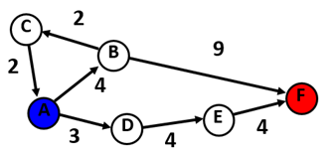
A* search
Review
Strategy: expand node with smallest g(n)+h(n) first.
g: cost from initial node to current node
h: heuristic from current node to goal node
h(A) = 9, h(B) = 5, h(C) = 9, h(D) = 6, h(E) = 3, h(F) = 0

Slide 7
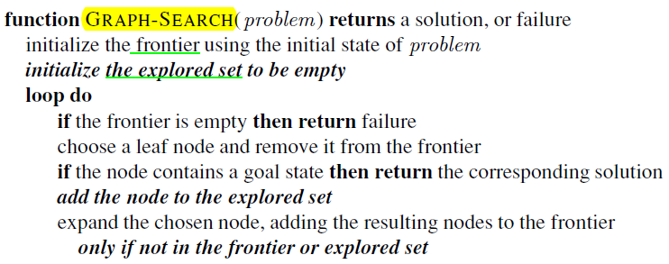
A* search
General search algorithm:
In the loop:
Choose a node from frontier (according to prioroty,then update explored set)
Expand the chosen node (find its successors, check if each successor can be added to frontier)
Notes:
不同搜索方法的主要区别就在于选择frontier里面的节点方式的不同。例如，前面的BFS是选择最早加入队列的节点，DFS是选择在栈的最上面，也就是最后加进去栈的节点；
这里的A*搜索，是选择frontier里面代价最小，也就是具有最高的priority的节点，从frontier里面拿出来，之后对这个节点来进行expand，找它的临近未访问节点，加入frontier。
在算法实现的细节上，还包括对这个选择的节点是否是目标节点进行判断，以及把它加入explored set，还有对新加入frontier的节点进行状态的更新等。

Slide 8
A* search
For shortest path search problem:
g: for each move from node i to j, g(j) = g(i) + edge(i,j)
h: one option of choosing heuristic is to use the geometry distance
for example:
h(A) = 9, h(B) = 5, h(C) = 9, h(D) = 6, h(E) = 3, h(F) = 0

Slide 9
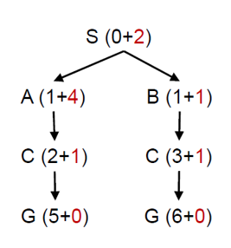
A* search
For shortest path search problem:
Implementation details:
openlist: stores frontier
openlist is a prior queue ordered by g+h values;
openlist.top() returns a node with smallest g+h;
closelist: stores explored nodes
closelist is an un-ordered list;
Each node: represents an actual node in state graph;
main data: node number, h and g,
a pointer to its parent node, in order to reverse the search path

Slide 10
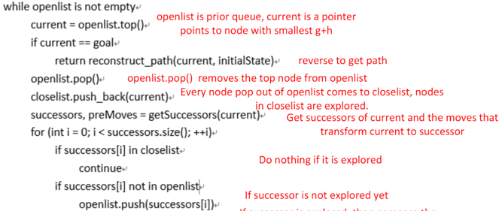
A* search
For shortest path search problem:
pseudo code：
else if current.g+edge(current,successors[i])>=successors[i].g
continue
successors[i]->preNode=current
successors[i]->h=computeHeuristic(successor->state)
successors[i]->g=current->g+1

Slide 11
A* search
Code overview：
priority_queue<GraphNode*,vector<GraphNode*>, cmpLarge> openlist;
vector<GraphNode*> closelist;
Graph graph;
GraphNode initNode,goalNode;
vector<int> resultPath;
openlist.top()
openlist.pop()
openlist.push()
clostlist.push()
Notes:
代码中用到的比较重要的数据结构，变量和数据的操作（优先队列openlist的push，pop和取top，以及closelist的push）

Slide 12
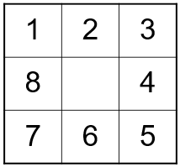
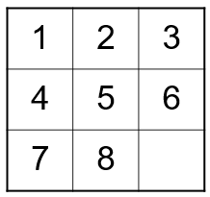
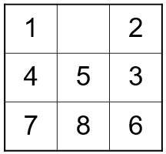
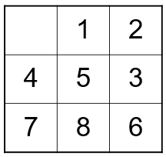
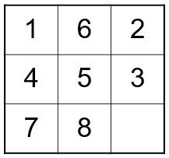
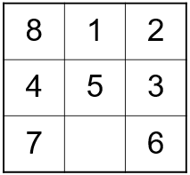
8 puzzle problem
Overview:
Use A* search;
Similar to A* searching shortest path problem;
Initial state: goal state:
State space:
Actions： move up,down,right and left
Cost: each step costs 1
…
Notes:
代码中用到的比较重要的数据结构，变量和数据的操作（优先队列openlist的push，pop和取top，以及closelist的push）

Slide 13
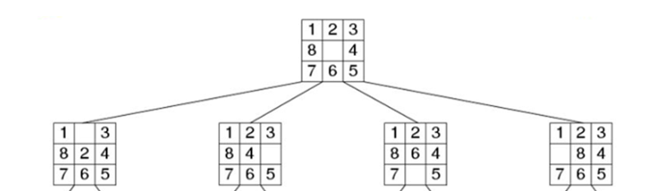
8 puzzle problem
Direction definition
down left up right
Explanation： the direction in which the neighbor node moves into the blank node;
Notes:
代码中用到的比较重要的数据结构，变量和数据的操作（优先队列openlist的push，pop和取top，以及closelist的push）

Slide 14
8 puzzle problem
General search algorithm
same as A* for searching shortest path problem.
Notes:
代码中用到的比较重要的数据结构，变量和数据的操作（优先队列openlist的push，pop和取top，以及closelist的push）

Slide 15
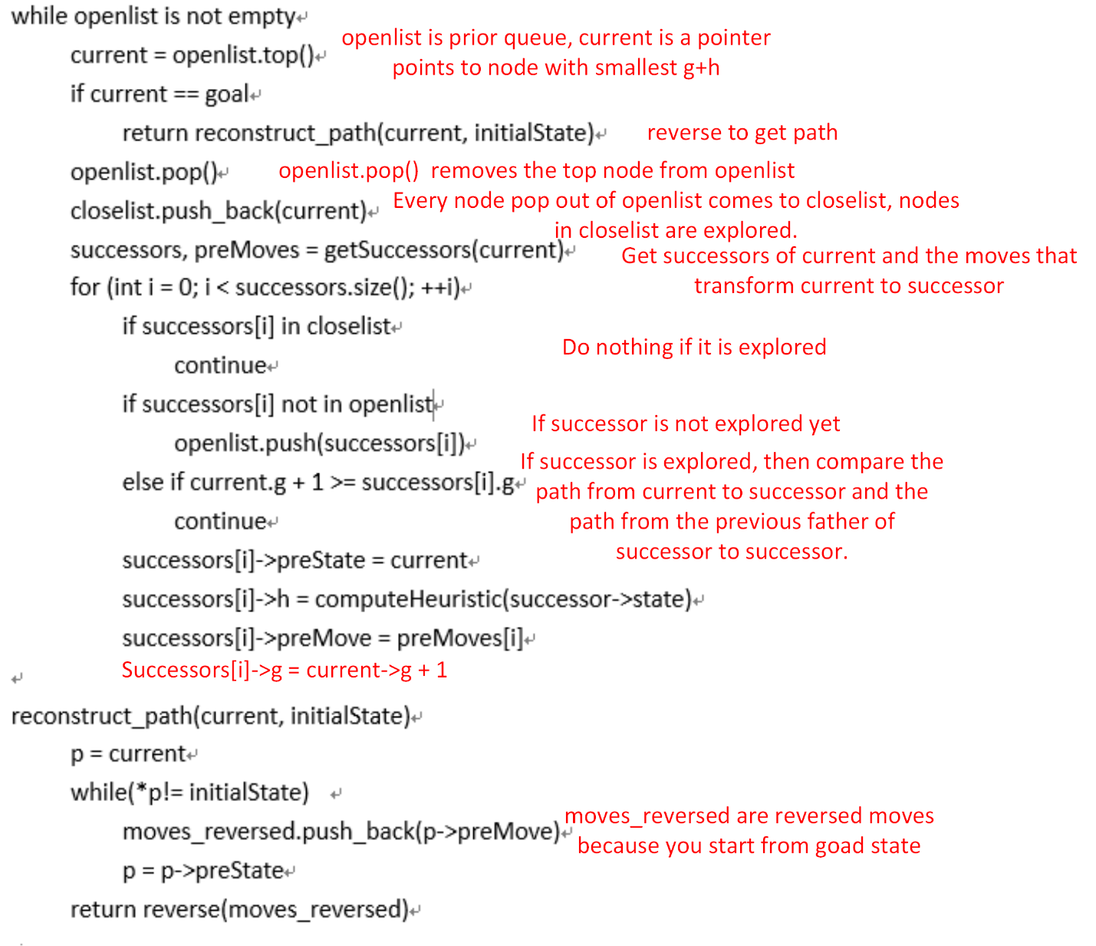
8 puzzle problem
Pseudo code
Notes:
代码中用到的比较重要的数据结构，变量和数据的操作（优先队列openlist的push，pop和取top，以及closelist的push）

Slide 16
8 puzzle problem
Code overview
priority_queue and vector
priority_queue<EightPuzzleState*,vector<EightPuzzleState*>, cmpLarge> openlist;
vector<EightPuzzleState*> closelist;
EightPuzzleState* state;
openlist.push(state)
state = openlist.top()
openlist.pop();
closelist.push_back(state);
Notes:
代码中用到的比较重要的数据结构，变量和数据的操作（优先队列openlist的push，pop和取top，以及closelist的push）

Slide 17
8 puzzle problem
Code overview
priority_queue and vector
priority_queue<EightPuzzleState*,vector<EightPuzzleState*>, cmpLarge> openlist;
vector<EightPuzzleState*> closelist;
EightPuzzleState* state;
openlist.push(state)
state = openlist.top()
openlist.pop();
closelist.push_back(state);

Slide 18
notation
For A* search for shortest path & 8 puzzle problem
Make sure you understand every step in pseudo code before you start coding.
Allocate memory for every successors, otherwise you can’t trace back to initial state.
Use simple cases for debugging.

Slide 19
notation
About submitting your code:
Zip your BFS_DFS.hpp, BFS_DFS.cpp, AStar.hpp, AStar.cpp,eightpuzzle.hpp and eightpuzzle.cpp to XXXXXXXX_project_1.zip, XXXXXXXX stands for your student ID, and submit it to FTP.

